Slide 1
CMSC 471 Intro to AI
Lecture 1:
What is AI?

Slide 2
What is AI?
Q. What is artificial intelligence?
A. It is the science and engineering of making intelligent machines, especially intelligent computer programs. It is related to the similar task of using computers to understand human intelligence, but AI does not have to confine itself to methods that are biologically observable.
http://www-formal.stanford.edu/jmc/whatisai/

Slide 3
Ok, so what is intelligence?
Q. Yes, but what is intelligence?
A. Intelligence is the computational part of the ability to achieve goals in the world. Varying kinds and degrees of intelligence occur in people, many animals and some machines.
http://www-formal.stanford.edu/jmc/whatisai/

Slide 4
Every AI must mention the 1956 Dartmouth Conference…

Slide 5
1956 Dartmouth AI Project
“We propose that a 2 month, 10 man study of artificial intelligence be carried out during the summer of 1956 at Dartmouth College in Hanover, New Hampshire. The study is to proceed on the basis of the conjecture that every aspect of learning or any other feature of intelligence can in principle be so precisely described that a machine can be made to simulate it. An attempt will be made to find how to make machines use language, form abstractions and concepts, solve kinds of problems now reserved for humans, and improve themselves. We think that a significant advance can be made in one or more of these problems if a carefully selected group of scientists work on it together for a summer.”
http://www-formal.stanford.edu/jmc/history/dartmouth/dartmouth.html
Courtesy Tim Finin

Slide 6
… but don’t think AI started there…

Slide 7
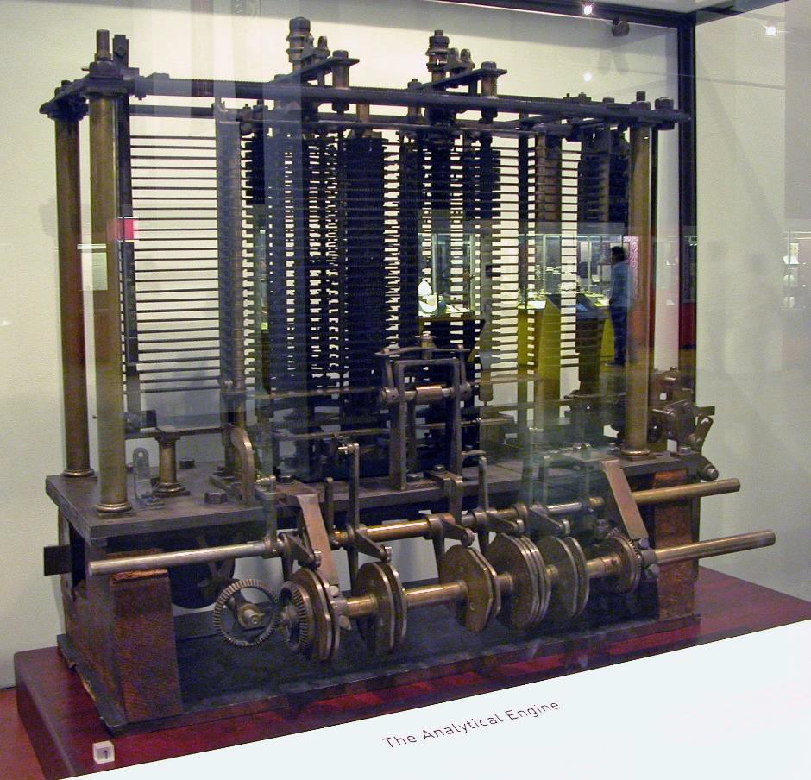
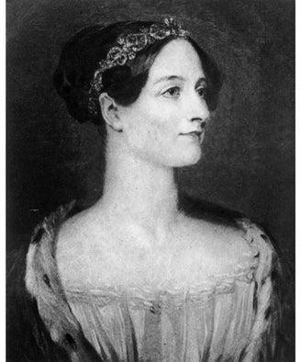
Analytical Engine - Wikipedia
Ada Lovelace Day Honors "the First Computer Programmer" - Scientific American Blog Network
"The Analytical Engine has no pretensions whatever to originate anything. It can do whatever we know how to order it to perform. It can follow analysis; but it has no power of anticipating any analytical relations or truths."

Slide 8
AI prehistory and early years
George Boole invented propositional logic (1847)
Karel Capek coined term robot in play R.U.R. (1921)
John von Neumann: minimax (1928)
Norbert Wiener founded field of cybernetics (1940s)
Neural networks (40s & 50s) among the earliest theories of how we might reproduce intelligence
Isaac Asimov I, Robot (1950) Laws of Robotics
Turing test proposed in 1950 & debated ever since
Early work on Chess by Alan Turing, 1950

Slide 9
How popular is AI?
AI has had it’s ups and downs
50-60 up, 70s down, 80s up, 90s down, 00s up, 10s up, 20s up, …
Hot topics today?
Neural networks again: deep learning
Machine learning, datamining
Exploiting big data
Autonomous vehicles, robotics
Text mining, natural language technology, speech
Computer vision

Slide 10
Why AI?
Engineering: get machines to do useful things
e.g., understand spoken natural language, recognize individual people in visual scenes, find the best travel plan for your vacation, …
Cognitive Science: model and understand how natural minds and mental phenomena work
e.g., visual perception, memory, learning, language, decision making, …
Philosophy: explore basic, interesting and important philosophical questions
e.g., mind-body problem, what’s consciousness, free will, …

Slide 11
What can AI systems do?
Computer vision: face recognition from a large set
Robotics: autonomous (mostly) automobile
Natural language processing: useful machine translation and simple fact extraction
Expert systems: medical diagnosis in narrow domains
Spoken language systems: e.g., Google Now, Siri, Cortana
Planning and scheduling: Hubble Telescope experiments
Learning: text categorization into ~1000 topics
User modeling: Bayesian reasoning in Windows help (the infamous paper clip…)
Games: Grand Master level in chess (world champion), checkers,…

Slide 12
What can’t AI systems do yet?
Understand natural language robustly (e.g., read and understand articles in a newspaper)
Surf the web and find interesting knowledge
Interpret an arbitrary visual scene
Learn a natural language
Construct plans in dynamic real-time domains
Refocus attention in complex environments
Perform life-long learning
Exhibit true autonomy and intelligence!

Slide 13
AI Vs Machine Learning
Artificial
Intelligence
Machine Learning
Deep Learning

Slide 14
Course Goals
Be introduced to some of the core problems and solutions of AI (big picture)
Learn different ways that success and progress can be measured in AI

Slide 15
Course Goals
Be introduced to some of the core problems and solutions of AI (big picture)
Learn different ways that success and progress can be measured in AI
Relate to other fields/disciplines

Slide 16
Course Goals
Be introduced to some of the core problems and solutions of AI (big picture)
Learn different ways that success and progress can be measured in AI
Relate to other fields/disciplines
Implement AI programs

